Slide 1

Intrusion Detection and Prevention System using Smart Contracts
Presenter: Aashish Singh
Roll No: 229301585
Project Guide: Dr. Prashant Vats
Date: February 2025

Slide 2

Introduction & Motivation
Context:
Cybersecurity threats and network intrusions are on the rise.
Traditional systems are often manual, error-prone, and vulnerable to brute-force attacks.
Motivation:
Develop a robust, automated system to detect and prevent unauthorized access.
Enhance security using modern web technologies, with plans for blockchain-based logging and ML-driven threat prediction.

Slide 3

Project Objectives
Main Objectives:
Build a web-based IDPS that uses JWT-based authentication.
Monitor network traffic in real-time to detect suspicious activities.
Log intrusion events with detailed information (IP address, user agent, geolocation, etc.).
Implement rate limiting to mitigate brute-force attacks.
Future Enhancements:
Integrate blockchain for immutable, tamper-proof logging.
Apply machine learning for predictive threat analysis and anomaly detection

Slide 4
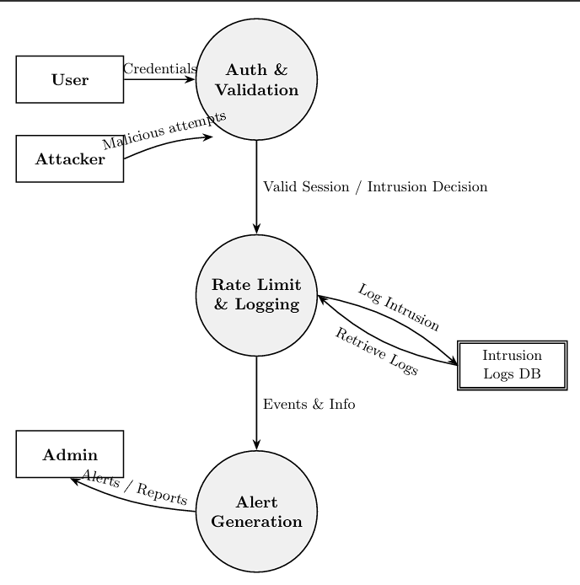
System Architecture Overview
Architecture Components:
Front-End: React with Vite; Zustand for state management.
Back-End: Node.js with Express; MongoDB for data storage.
Security: JWT authentication, rate limiting, and intrusion logging.
Communication:
Axios (configured to send HTTP-only cookies) for secure API calls.

Slide 5

Detailed Module Descriptions
Authentication & Validation:
Validates user credentials.
Issues JWT tokens.
Rate Limiting & Intrusion Logging:
Monitors and limits excessive requests.
Logs intrusion events with geolocation details.
Alert Generation:
Generates real-time alerts and reports for admin users.
Data Storage:
Intrusion Logs DB in MongoDB.

Slide 6
Technologies and Tools
Front-End:
React
Back-End:
Node.js, Express, JWT
Testing Tools:
Postman
Future Tools:
Blockchain (Ethereum, Solidity)
Machine Learning (TensorFlow, scikit-learn)
Vite
Zustand
Tailwind CSS
Nodemailer, geoip-lite, MongoDB
Mongoose
Mocha, Chai,
Chrome Developer Tools

Slide 7

Implementation Highlights
Architecture:
MVC (Models, Views, Controllers)
Security Measures:
JWT-based authentication and secure HTTP-only cookies.
Custom middleware for rate limiting and intrusion logging.
Logging:
Detailed intrusion logs (failed logins, suspicious activities) stored with geolocation data.
Dashboard:
Separate dashboards for admin (detailed security metrics) and regular users (personal account status).

Slide 8

Testing & Evaluation
Testing Approach:
Unit Testing: Using Mocha & Chai for back-end modules.
Integration Testing: API endpoint testing with Postman/Insomnia.
Functional Testing: End-to-end testing simulating real user scenarios.
Security Testing: Stress tests to trigger rate limiting and validate 429 responses.
Outcomes:
Robust authentication and intrusion detection.
Effective logging of security events.
Responsive admin dashboard with real-time alerts.

Slide 9
Future Enhancements
Blockchain Integration:
Machine Learning Enhancements:
Mobile App Development:
Use Ethereum smart contracts to store cryptographic hashes of intrusion logs.
Achieve immutable, tamper-proof audit trails.
Analyze historical intrusion data to detect patterns.
Predict and mitigate potential threats in real-time.
Provide real-time alerts and remote management via mobile.
Advanced Analytics
Enhance dashboards with detailed data visualization and reporting

Slide 10
Conclusion & Final Thoughts
Summary:
The IDPS project successfully integrates secure authentication, real-time intrusion monitoring, and detailed event logging.
Modular design ensures scalability and a foundation for future blockchain and ML enhancements.
Final Thoughts:
Emphasis on the importance of proactive security measures.
Future work will further enhance threat detection and system integrity.

